Slide 1

TEMA Southeast Chapter

Slide 2
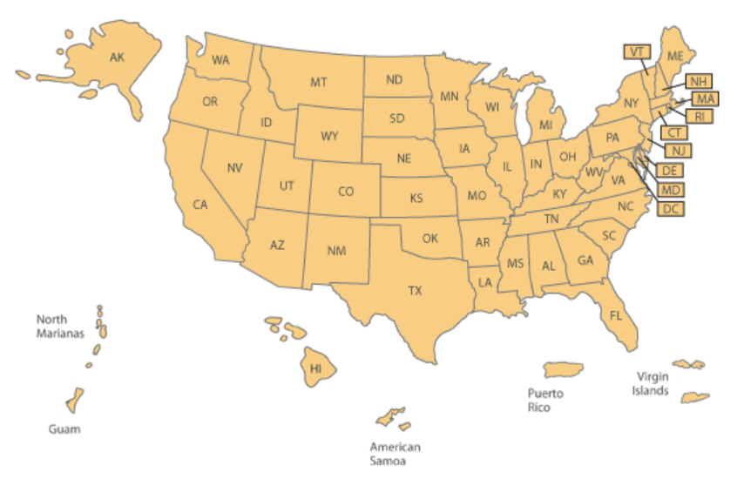

State Energy Office (SEO) Locations
50 states
District of Columbia
Five U.S. Territories
Notes:
American Samoa
Guam
Northern Marianas
Puerto Rico
U.S. Virgin Islands

Slide 3
Texas State Energy Conservation Office
Comptroller of Public Accounts
Tool that CPA uses to assist state agencies and other public entities

Slide 4

SECO Purpose
Designed by Freepik
Promote the efficient use of energy
Reduce energy demand

Slide 5


Target Audiences
Designed by Freepik
Public K-12 school districts
Public higher education
Local and county governments
State agencies
Public hospitals
Quasi governmental entities

Slide 6

Programs
Energy Education and Training
Technical Assistance
Emerging Clean Energy Technology
LoanSTAR Revolving Loan Program
Notes:
Provides technical assistance to increase energy efficiency and conservation.
Promotes education to professionals, higher education and elementary school students.

Slide 7

Energy Education and Training
Watt Watchers of Texas
City Efficiency Leadership Council
Texas Industrial Energy Efficiency Program
HVAC Practitioner Energy Code Training
Energy Code Training
Notes:
Lil Tex and Ann

Slide 8
Technical Assistance
Preliminary Energy Assessments
Technical Assistance

Slide 9
Technical Assistance Requests
Common Requests:
Improve Maintenance and Operations
Lighting Upgrades (Indoor / Outdoor)
Smart Meters
Upgrade HVAC / Chiller / Boiler
Update Building Control
ENERGY STAR certification

Slide 10
LoanSTAR Overview
Maximum loan size per application $8 million ($3 million min for repaid ARRA)
Maximum number of loans per application period Three per applicant
Interest Rates General fund - annual rate of 2 percent Repaid ARRA fund - annual rate of 1 percent.
Application Review First-come, first-served basis.
Application Submission Deadline August 31, 2023

Slide 11
Statutory Activities
Energy Code Adoption
Energy Reporting
Notes:
Energy Code Adoption:
Commercial and Multi-Family, Single Family, State-Funded Buildings, Texas Water Conservation Standards
Energy Reporting:
State Agencies and Institutions of Higher Education, Local Governments, Municipally Owned Utilities and Coops

Slide 12
H.R. 3684 (bills-117hr3684enr.pdf)
Infrastructure Investment and Jobs Act
Inflation Reduction Act

Slide 13

Reporting
Match
Build America
Buy America
Davis Bacon
Historic Preservation
NEPA (National Environmental Policy Act)
Disadvantaged Communities
https://www.123rf.com/photo_11283926_cute-kid-with-an-expression-of-great-surprise.html

Slide 14

Eddy Trevino Director State Energy Conservation Office eddy.trevino@cpa.texas.gov
www.seco.cpa.texas.gov
14

